Slide 1
CSE 3430 Overview of Computer Systems For Non-Majors
Part 2

Slide 2
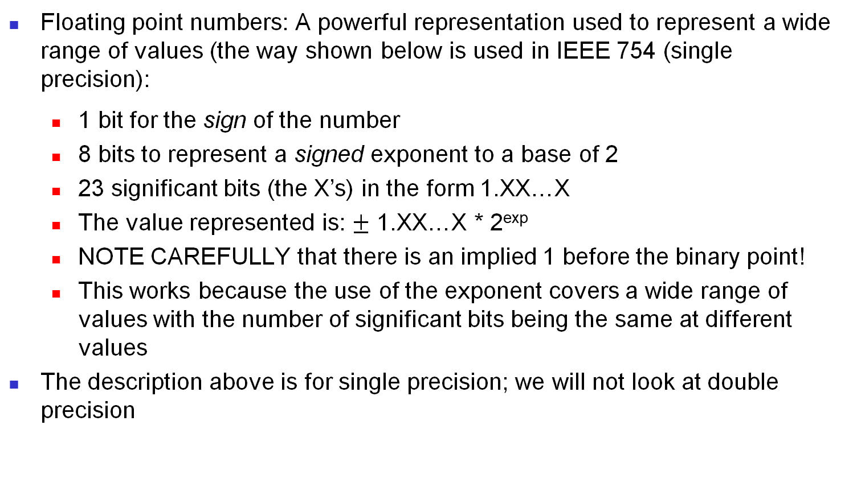
Storing Information (contd.)
Floating point numbers: A powerful representation used to represent a wide range of values (the way shown below is used in IEEE 754 (single precision):
1 bit for the sign of the number
8 bits to represent a signed exponent to a base of 2
23 significant bits (the X’s) in the form 1.XX…X
The value represented is: $±$ 1.XX…X * 2^{exp}
NOTE CAREFULLY that there is an implied 1 before the binary point!
This works because the use of the exponent covers a wide range of values with the number of significant bits being the same at different values
The description above is for single precision; we will not look at double precision

Slide 3
IEEE 754
The most common way of encoding floating point numbers is using a standard called IEEE 754 (IEEE is Institute of Electrical and Electronics Engineers)
IEEE 754 is used for floats on Intel based PCs, Macs, and most Unix and Linux platforms (but other ways of representing floats are used in some systems).
We will only look at single-precision (32 bit) encoding; although 64-bit encoding works in the same way, just with more bits to represent floating point numbers with a larger range and greater precision, doing 64-bit problems is impractical for our purposes.

Slide 4
IEEE 754 continued
In this standard, the first bit (msb) encodes the sign of the number, 0 for non-negative, and 1 for negative
The next 8 bits encode the exponent, but the exponent is encoded with a bias (a number added to the true exponent); to get the true exponent (exp), subtract 127 (the bias).
It is really important to distinguish the biased exponent (what is encoded as part of the bit string which stores the floating point value) from the true exponent (what you need to determine the value of the floating point number encoded)
For a 32 bit IEEE 754-encoded number, the format is:
X YYYYYYYY ZZZZZZZZZZZZZZZZZZZZZZZ
(1-bit sign) (8-bit biased exponent) (23-bit mantissa)
The standard form of the encoded number is (NOTICE the implied 1):
(-1)^{X} * 1.ZZZZZZZZZZZZZZZZZZZZZZZ * 2^{exp}
REMEMBER: exp in the formula above is the true exponent, NOT the biased exponent (which is the exponent represented as part of the 32 bit encoding).
ALSO NOTE: The 1 before the . (the binary point, since it's base 2) is not part of the encoding; it is implied.

Slide 5
Example
Let’s look at how to get the decimal value of an IEEE 754 encoded floating point number with an example (spaces are used to separate the parts of the encoding – sign/exponent/mantissa):
1 10000011 01011100000000000000000
Step 1: Since the sign bit is 1, the number is negative.
Step 2: Get the exp (true exponent). The encoded exponent is 10000011
What is the decimal value of the exponent?
Subtract the bias (127) from the biased exponent to get the true exponent.
What is the true exponent (exp)?
Step 3: Write the binary value of the floating point number in standard form.
Step 4: Convert the floating point number to decimal.
Analysis on the following slides.

Slide 6
Example (Steps explained on following slides)
Let’s look at how to get the decimal value of an IEEE 754 encoded floating point number with an example (spaces are used to show the parts of the encoding – sign/exponent/mantissa):
1 10000011 01011100000000000000000
Step 1: Since the sign bit is 1, the number is negative.
Step 2: Get the exp (true exponent). The encoded exponent is 10000011
What is the decimal value of the encoded exponent: 128 + 2 + 1 = 131
Subtract the bias (127) to get the true exponent: 131 – 127 = 4
What is the true exponent (exp): 4
Step 3: Write the binary value of the floating point number in standard form:
1.010111 X 2⁴ (NOTE: Only bits up to and including the rightmost 1 are written)
Step 4: Convert the floating point number to decimal (See slides below for details), and include the negative sign, if the sign bit was 1 (details on how to do the conversion are given below on the following slides):
10101.11 = -21.75

Slide 7
Another example (with details)
Let’s try this IEEE 754 encoded number, and see what we get:
0 10000001 00010000000000000000000

Slide 8
Step 1
0 10000001 00010000000000000000000
Step 1: Since the sign bit is 0, the number is positive.

Slide 9
Step 2
0 10000001 00010000000000000000000
Step 2: Get the exp (true exponent). The encoded (biased) exponent is 10000001
What is the decimal value of the biased (encoded) exponent?
10000001 = 128 + 1 = 129
Subtract the bias (127) to get the true exponent:
exp = 129 – 127 = 2
So exp (the true exponent) is 2

Slide 10
Step 3
Step 3: Write the binary value of the floating point number in standard form.
To do this, write the 23 least significant bits of the original IEEE 754 encoded number (the mantissa) after the implied 1. (we can omit any 0’s on the right side, after the last 1 in these last 23 bits) X 2^{exp}
For our problem, since exp is 2 (from step 2 above) this is:
1.0001 X 2²
NOTICE: The 19 0’s on the right of the mantissa have been omitted from 00010000000000000000000 (the 23 least significant bits from the original IEEE 754 encoded number). They can be omitted because they do not change the value (0's on the far right of the mantissa can always be omitted when converting to decimal).

Slide 11
Step 4: Conversion to decimal
To eliminate the exponent, move the binary point (or radix point) to the right for a positive exp (true exponent), or to the left for a negative exp (true exponent): in our problem, since exp is positive 2, move the binary point to the right 2 places:
100.01
Now, convert the binary number to decimal.
The integer part (to the left of the binary point), 100, is 4
To get the fractional part, treat the bits to the right of the binary point as a whole number, and divide by 2(number of bits up to, and including, the rightmost 1)
.01 = 1/(2²) =¼ or .25, so the number is 4.25
Add sign: negative if sign bit was 1, or positive if sign bit was 0; here it was 0, so the number is +4.25 or just 4.25

Slide 12
Example with negative exp (true exponent)
Let’s try this example:
0 01111110 10100000000000000000000
Step 1: Since the sign bit is 0, the number is positive.
Step 2: Get the exp (true exponent). The encoded exponent is 01111110
What is the decimal value of the exponent?
Subtract the bias (127).
What is the true exponent (exp)?
Step 3: Write the binary value of the floating point number in standard form.
Step 4: Convert the floating point number to decimal.

Slide 13
Example with negative exp (true exponent)
Let’s try this example:
0 01111110 10100000000000000000000
Step 1: Since the sign bit is 0, the number is positive.
Step 2: Get the exp (true exponent). The (biased) encoded exponent is 01111110
What is the decimal value of the exponent: 64 + 32 + 16+ 8 + 4 + 2 = 126
Subtract the bias (127): 126 – 127 = -1
What is the true exponent (exp): -1
Step 3: Write the binary value of the floating point number in standard form.
Step 4: Convert the floating point number to decimal.

Slide 14
Step 3
Step 3: Write the binary value of the floating point number in standard form.
To do this, write the 23 least significant bits of the original IEEE 754 encoded number (the mantissa) after the implied 1. (we can omit any 0’s on the right side) X 2^{exp}
For our problem, since exp is -1 (from step 2 above) this is:
1.101 X 2⁻¹
NOTICE: The 20 0’s on the right have been omitted from 10100000000000000000000 (the 23 bits of the mantissa from the original IEEE 754 encoded number); 0’s on the right can always be omitted without changing the value when converting to decimal.

Slide 15
Step 4: Conversion to decimal
To eliminate the exponent, move the binary point (or radix point) to the right for a positive exp (true exponent), or to the left for a negative exp (true exponent): in our problem, since exp is -1, move the binary point to the left 1 place:
0.1101
Now, convert the binary number to decimal.
The integer part (to the left of the binary point), 0, is 0
To get the fractional part, use the same method as before: Treat the bits to the right of the binary point as a whole number, and divide by 2(number of bits up to and including the rightmost 1)
.1101 = 13/(2⁴) = 13/16 or 0.8125, so the number is 13/16 (It is fine to write it this way; you do not need to convert to 0.8125 with a calculator).
Add sign: negative if sign bit was 1, or positive if sign bit was 0; here, it was 0, so the number is: 13/16 or 0.8125 (13/16 is fine)

Slide 16
Values way below 1 and close to 0
As we saw in the example above, if the exponent (exp) is negative, floating point numbers can be used to represent values which are less than 1.
If the exponent is negative and very far below zero (say -120 or less), positive numbers can be represented which are extremely small; that is very much less than 1, i.e., extremely close to 0 (or negative numbers which are much greater than –1, i.e, extremely close to 0, but negative).
The range of exponents in IEEE 754 single precision is:
Biased exponent range: 0 – 255
True exponent range (explanation below): -126 to 127

Slide 17
Range of exp
What is discussed above is only for values of exp from -126 to 127 (biased, or encoded, exponents from 1 to 254). Such values are called normalized numbers in IEEE 754.
With this range of true exponents, we can encode floating point numbers in the range: +/- 1.0 X 2⁻¹²⁶ to +/- 1.0 X 2¹²⁷
If the encoded exponent is 0 (all 8 bits of the exponent are 0’s), the number is a denormalized number. This can be used to represent 0, and values with absolute value much less than 1, that is, values extremely close to 0 (just below or just above 0).
We will not consider these values.
Numbers that have a biased exponent of 255 (all 8 exponent bits are 1) are used to encode +/- infinity (overflow), and errors (values that are not real numbers, for example, the square root of a negative number).

Slide 18
Comparison of float range and integer range
If we compare the range of floats using IEEE 754 single precision to 32-bit signed integers, we can see floats have a tremendously larger range:
Floats: +/- 1.0 X 2⁻¹²⁶ to +/- 1.0 X 2¹²⁷
Signed ints (B2T): -2³¹ to 2³¹ – 1

Slide 19
Floating Point Range
Therefore, floating point numbers represented in this way have a tremendous range compared with int representation. For non-negative floats, we can represent:
0
From values which are extremely small, but close to 0, to values which are extremely large, much larger than the largest integer which can be represented, even with a 64-bit encoding.
Thus, if we want tremendous range, but are willing to trade some precision, we can use floating point data types.
If we want perfect precision, but much more limited range, we need integer types.
SOME encoded floats represent real number values precisely, but only if the number can be written in the form (+/-) x/y where y is an integer of the form 2^{n}, for integer n > 0.
So, fractional values such as 1/5 cannot be stored precisely in binary; they can only be approximated. Likewise, 1/3, 1/6, 1/7, 1/9, etc. can only be approximated in binary representation with a finite number of bits. The approximation is very good generally, but it is important to understand that it is only an approximation in these cases (a large percentage of cases)!

Slide 20
Character representation
Characters
There are various encoding schemes which are used
For the Latin alphabet and related characters, and decimal digits (0 to 9) one early system (still being used) is ASCII (American Standard Code for Information Exchange): Corresponding to each character, there is a unique 8 bit code Example: ‘A’ has the code 0100 0001; ‘B’ has code 0100 0010 ‘7’ has code 0011 0111; ‘8’ has code 0011 1000; Why? … because! (it is an accepted standard)
Please see the ASCII table posted on Carmen

Slide 21
ASCII – Important Point
Please note that the most significant bit (the msb, that is, leftmost bit) in an ASCII character encoding is always 0.
This means that the msb can be used to detect errors in the transmission of character data, for example, across a network connection (see discussion of how this can be done below).

Slide 22
Other methods of character encoding – UTF-8
Because ASCII uses only 7 bits (remember that the msb is always 0), it can encode a very limited number of characters.
How many?
If we want an encoding for a larger character set, what can we do?

Slide 23
Other methods of character encoding (cont)
Right – the same answer as always - use more bits (longer bit strings)!
UTF-8
Unicode
Each character is encoded by one to four 8 bit bytes (it is a variable byte-length character encoding method).
NOTE: The UTF-8 encoding is the same as the ASCII encoding for characters encoded by ASCII

Slide 24
UTF-8
UTF-8 can encode Unicode characters. Unicode is an extremely large character set, and currently includes 1,112,064 characters!

Slide 25
UTF-8 (cont)
This is a large enough number to include encodings for Latin-script alphabets, Greek, Cyrillic (used for Russian and other Slavic languages), Coptic, Armenian, Hebrew, Arabic, Syriac, Thaana, and the N’Ko alphabets, as well as diacritical marks (accents, etc.), and also including Chinese, Japanese, and Korean characters.
Actually, it includes an encoding for every character in every known language that has a writing system!

Slide 26
Why is it called UTF-8?
The name UTF-8 comes from Unicode (or Universal Coded Character Set) Transformation Format – 8-bit (You do not need to remember this!)

Slide 27
How does it work?
UTF-8 appears somewhat complicated, but the basic idea is quite simple.
First, UTF-8 uses a variable length encoding of 1 to 4 bytes for every character.
That is, the number of bytes used to encode various characters is variable (some characters use 1 byte, some use 2, some use 3, and some use 4).
Although the encoding of any particular character always uses the same number of bytes, encoding of two different characters may use a different number of bytes.

Slide 28
UTF-8 – How does it work (cont)
If each character has a variable byte-length encoding (1, 2, 3, or 4 bytes for UTF-8), how does the decoder (software, or perhaps a human being, such as you or me ☺ ) know the length of the character encoding?
A clever scheme is used to handle this, explained on the next slide.

Slide 29
UTF-8 – Variable byte length encoding
The scheme is shown on the next slide, with the bits marked x actually used to encode the character (each of these bits, of course, can be 0 or 1, depending on the specific character being encoded).
The bits that are not represented by x can be thought of as formatting bits; they convey information about the encoding, and not about the specific character represented. These bits always come at the beginning of the byte (they are the msbs).

Slide 30
UTF-8 variable byte length encoding
Number of bytes | Range of codes (decimal) | Number of significant bits | 1st byte | 2nd byte | 3rd byte | 4th byte
1 | 0-127 | 7 | 0xxx xxxx | ------------ | ------------ | ------------
2 | 128-2047 | 11 | 110x xxxx | 10xx xxxx | ------------ | ------------
3 | 2048-65535 | 16 | 1110 xxxx | 10xx xxxx | 10xx xxxx | ------------
4 | 65536-2097151 | 21 | 1111 0xxx | 10xx xxxx | 10xx xxxx | 10xx xxxx

Slide 31
UTF-8 conclusion
Since 2009, UTF-8 has been the dominant character encoding scheme for the World Wide Web
It now accounts for approximately 93% of all web pages (some of these are pages use just ASCII, but ASCII and UTF-8 are equivalent for one-byte encoded UTF-8 characters) [Please don't worry about remembering the percentage!]

Slide 32
Aside on Hexadecimal
Hexadecimal (base 16) is used fairly often in computer science, because it is easy to convert to or from binary to hex.
Every sequence of 4 bits (every half-byte, or "nibble") can be converted to or from hex directly, as follows:
Binary Hex Binary Hex
0000 0 1000 8
0001 1 1001 9
0010 2 1010 A
0011 3 1011 B
0100 4 1100 C
0101 5 1101 D
0110 6 1110 E
0111 7 1111 F

Slide 33
UTF-8 example – Greek characters (Please don’t memorize these!)
Here are some UTF-8 codes for some Greek characters many of us may be familiar with:
Notice that all of the UTF-8 codes for Greek characters are two-byte codes (4 hex digits)
Greek character | UTF-8 code (hex)
Δ (uppercase delta) | 0xCE94
π (lowercase pi) | 0xCF80
Π (uppercase pi) | 0xCEA0
Σ (uppercase sigma) | 0xCEA3
θ (lowercase theta) | 0xCEB8

Slide 34
Character strings
Character strings: Stored in a sequence of bytes. Thus “B7A” (encoded in ASCII) is:
B 7 A 0100 0010 0011 0111 0100 0001
Or, more readably, in hex (hexadecimal, or base 16): 0x423741 (the prefix 0x is usually used to indicate that a number is hex; see explanation below of how to convert binary to hexadecimal).

Slide 35
Error Detection/correction
Information stored in the computer usually remains unchanged … but
During transmission (e.g., over a network), errors can creep in.
Simple error detection method: parity; for ASCII, use eight bits instead of 7 (the value of 8th bit being chosen to get even number of 1’s)
An error detection/correction scheme: (VPB: Vertical parity bit; HPB: horizontal parity bit; top right: “corner bit” H e l l o , w o r l d HPB VPB 0 0 0 0 0 1 1 0 0 0 0 1 1 bit 6 1 1 1 1 1 0 0 1 1 1 1 1 0 bit 5 0 1 1 1 1 1 1 1 1 1 1 1 1 bit 4 0 0 0 0 0 0 0 1 0 1 0 0 0 bit 3 1 0 1 1 1 1 0 0 1 0 1 0 1 bit 2 0 1 1 1 1 1 0 1 1 0 1 1 1 bit 1 0 0 0 0 1 0 0 1 1 1 0 0 0 bit 0 0 1 0 0 1 0 0 1 1 0 0 0 0
Notes:
The top row is “vertical parity bit” chosen so each column has even number of 1s
The right column is horizontal parity bit chosen so each rown has even no. of 1’s
The top right corner is chosen so that the number of 1’s in LPB and HPB are even – interestingly, the same bit value for the corner bit does the trick for both LPB and HPB!

Slide 36
Storing Information (contd.)
What about other values?
Say, I want to store the grades that a given student obtains in all the homeworks, exams, etc.? Just use the appropriate number of words or bytes: Let us say there are ten graded activities each worth a max of 100 pts We could store each of these in a single byte (why?) but it is more common to use a whole word; And use two words to store the name of the student (why?) for a total of 12 words
What if I want to store the grades of all the students in the class? Just use N * 12 words (if there are N students in the class)
*But*: If I look at the actual contents of these words in memory, it will just be a sequence of 0’s and 1’s! I have to know what each byte represents
For example, suppose I thought there were 12 (instead of 10) graded activities, what will happen?

Slide 37
Storing Information (contd.)
What about other values? Say a song that you downloaded (legally:-)?) or a photo? or video?
For each type of data, standard coding schemes have been defined so that each such “value” can be stored as a (looo…ng!) sequence of bits
In each case, if you don’t know the coding scheme, there is no way for you to know what song or photo or video a given string of bits is …
In fact, you can’t even be sure whether it is a song or a photo or video!
… or the grade roster of a course!
Essential point: Everything in the computer is stored as bit strings. You have to know which value is stored where in memory and what the encoding scheme used to store that value is, in order to be able to interpret (get the meaning of) the encoded data.

Slide 38
Organization of Memory
Memory is organized as an array of bytes; each byte in the memory array has an index (just as elements of other types of arrays have indexes), and this index of the memory byte is called an address. System addresses always start with index 0.
In some architectures, memory is byte-addressable (data beginning at any byte in memory can be accessed, that is, read or written).
BUT, in other architectures, addresses must be word-aligned (the only data which is accessible is data which starts at a byte index which is evenly divisible by the size of a word).
So, in a system which requires aligned access and has an 8-byte word size, only data which starts at an address evenly divisible by 8 could be read or written; 8-byte data starting at address 3, or 7, or 75, for example, could not be accessed.

Slide 39
Memory Structure
Memory consists of a huge number of bytes (of 8 bits each)
Each byte in memory has a unique address
If the memory has 10 bytes, their addresses will be 0, 1, 2, …, 9
… represented as bit strings (0000, 0001, 0010, …, 0111, 1001, 1010) … because everything is represented as a bit string!
In a typical machine today, the address is represented as a 64-bit string (or 16 hexadecimal digits), and the word size is 8 bytes. In the prior generation of computer systems, addresses were 32 bits, or 8 hexadecimal digits, and word size was 4 bytes.
Therefore, in the prior generation of machines, we could have a maximum of 4,294,967,296 bytes of memory (why?). In today's machines, we have that number of bytes squared (4,294,967,296 bytes squared) as the maximum amount of memory our machine can have (though real machines do not currently have that much)!
Numbers (integers and single-precision floats) are usually stored in 4 bytes, though the word size in a 64-bit machine is 8 bytes.

Slide 40
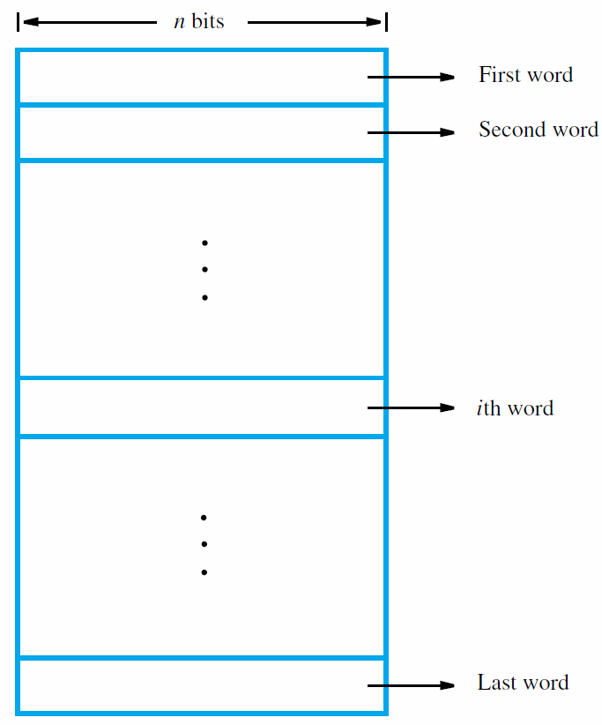
8 bits
byte
byte
or byte
or byte

